Slide 1
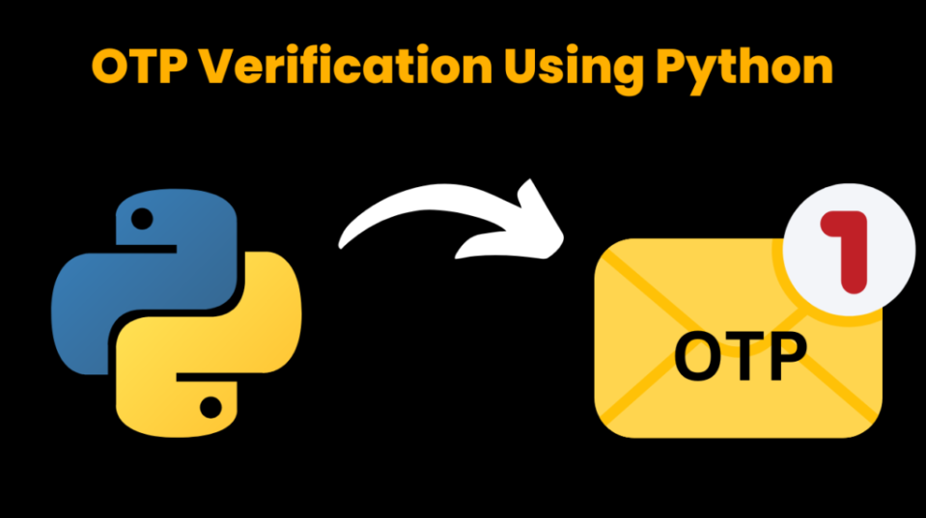
Capston Project - OTP Verification System
Name- Urmila Divekar
ID- S7116

Slide 2
Contents
Project Overview/Problem Statement
Technical Stack
About OTP
Generating OTP
SMTP
Challanges

Slide 3

Project Overview/Problem Statement
To develop OTP verification system in
jupyter (IDE Tool).
This system should generate 6 digit OTP
and send it to user email address via
SMTP server for verification.
If the user enter correct OTP access
should be granted otherwise access
denied.

Slide 4



Technical Stack

Slide 5

About OTP
OPT it is a password valid for only one login
session or transaction on a computer
system or other digital services.
Its add an additional security level.
Swiggy, Zomato, and online money
Transfer apps etc uses OTP for verification.

Slide 6
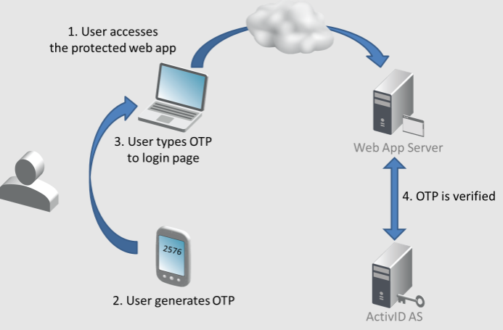
Generating OTP
Import random module, using
random.randint function.
we will generate 6 digit OTP.
This OTP will be used for verification.

Slide 7
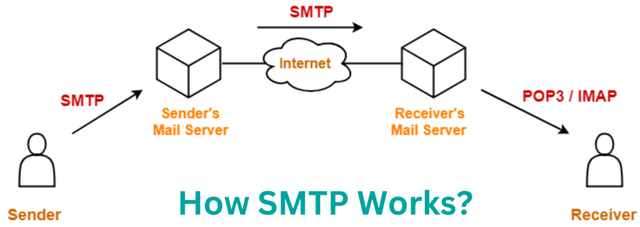
Simple Mail Transfer Protocol (SMTP)
Using smtplib module we can send email.
Create object for MIMEmultipart it takes
Parameters like object, from, to and message

Slide 8
Challanges
Errors-
SMTP authentication error-
Indicates that the authentication to the SMTP server failed. It happens due to incorrect email credentials or because of email provider requires additional security measures.
SMTP data error-
Indicate temporary issue with SMTP server.
The ‘try-except’ block helps to handle errors that can occur during the process of sending an email. Each specific except block provides a clear and informative message about the type of error that occurred.

Slide 9


